Slide 1
Pursuing a comprehensive assessment agenda for Functional Analytic Psychotherapy
The Functional Analytic Research Team University of Nevada-Reno

Slide 2
Psychometric measurement of interactions in- and out-of-session
Timothy Feeney, M.A.
Cory Stanton, M.S.*
William Follette, Ph.D.
University of Nevada-Reno
*presenting author
Notes:
Good morning everyone, and thank you for coming! I’ll be starting off our symposium by reviewing measurement issues and tools in the area of interpersonal interactions, both inside and outside the therapy session.

Slide 3
Need CE credit for this session?
Please don’t forget to scan in to have your attendance tracked!

Slide 4
Disclosure Statement
Timothy Feeney, Cory Stanton, & William Follette
We have not received and will not receive any commercial support related to this presentation or the work presented in this presentation

Slide 5
Goals
Understand the context we work in as behavior therapists and researchers
Discuss tools that may be useful to our analytic goals
Notes:
[Read 1st bullet] especially FAP, and [read 2nd bullet]

Slide 6
The problem (Follette & Hauts, 1996)
DSM focused on reliability, but placed validity on the back burner
The goal of a medical model is to describe the etiology, treatment, and course of a diagnostic category; therefore, it’s a binary outcome of disorder vs. no disorder
Notes:
[Read first bullet]
While it was not explicitly stated as a medical model, it did come out of a primarily medical tradition
[Read second bullet]

Slide 7
The problem
As contextualists and behaviorally inclined folks, that can be problematic for us
General goal: maximize the amount of reinforcement people have available to them, and minimize the amount of apparent aversive control
Values (Bonow & Follette, 2009)
Notes:
[Read first bullet]
Going as far back as Goldiamond (1974), clinical behavior analysis takes a constructional approach. Yes, its helpful to alleviate suffering, but that’s one of many goals in behavior therapy. [Click] We aim to equip our clients with the repertoire(s) necessary for maximizing the amount of reinforcement, and minimizing the amount of apparent aversive control in client’s lives. [Click] This can include considering what our client(s) find reinforcing, and aiding them in increasing their access to appropriate sources.

Slide 8
The problem
One goal in treatment is to get folks to interact with their environment successfully
Interpersonal success in all of its forms
Notes:
[Read first bullet] [Click]
Being social creatures that we are, whether its interacting with friends, acquaintances, family, romantic partners, or others, these relationships are frequently a target in therapy. Behavioral principles can be employed in order to achieve these goals.

Slide 9
Current considerations in our lab
Expanding the repertoire of assessment procedures to find out what real behavioral features are useful in accomplishing therapy goals
The functions of one’s social reinforcement repertoire
Notes:
The priorities of our lab right now, are expanding the assessment procedures used in FAP with an eye towards treatment utility, as well as understanding the range of functions that social behaviors have.

Slide 10
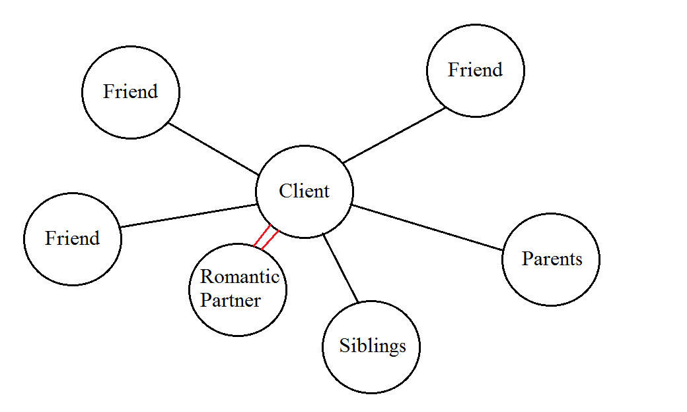
Notes:
Sometimes, a sociogram, or a diagram of an individual in relation to their social ties, can help clients and therapists visualize the social capital available to clients, while considering their goals for treatment.

Slide 11
The importance of interpersonal functioning
Many behavioral health presentations have a social component
Access to social support is important for adolescent and adult mental health (Seeman, 1996; Taylor, 2011)
The dyad is a common unit of analysis (Laursen, 2005)
Research
Clinical
Notes:
Now if you’re here, at a FAP oriented symposium, I’m willing to gamble that you already recognize that interpersonal relationships are a key ingredient to psychological health and functioning. Nonetheless, it’s useful to briefly review what we know.
[Read first two bullets]

Slide 12
The challenge of measuring it well
Being embedded in the analytic unit
Client and therapist histories
Notes:
So we know that interpersonal functioning and relationships are important. The conversation gets a bit harder when we try to figure out how to measure these constructs and their associated behaviors. [Click]. A therapist trying to understand how their interactions promote client well-being is hindered by the naturally occurring biases that come with having stimulus functions for the client. So being somewhere in the three term contingency. [Click]. In addition, what functions for one member of the dyad in a certain way, may or may not function that way for the other. The historical context is always relevant to the present context.

Slide 13
Providing compassion
Assertiveness
Resolving conflict
Speaking truth
Being effective
Expressing intimacy
Notes:
We can come up with an incredible diversity of terms by which to define and measure some aspect of interpersonal functioning. In general, terms are identified and conceptualized in a way relevant to some goal. For example, a client asking us for help with assertiveness is telling us that in certain contexts, they would like to be able to call upon a certain repertoire that is not currently present, or is present and has other barriers in the way of its use. And this is just one example; clients may not even be making contact with the knowledge that a repertoire deficit exists.

Slide 14
Functional Analytic Psychotherapy (Kohlenberg & Tsai, 1991)
A radical behavioral approach to psychotherapy focused on contingent responding in the context of an intimate therapeutic relationship
FAP researchers and clinicians are naturally oriented towards considering these issues
Notes:
So what does all of this have to do with FAP?
[Read first bullet]
FAP is a behavior therapy that explicitly targets the moment-to-moment interactions between client and therapist, not only as targets for change in and of themselves, but also as a mechanism by which the client will change their behavior outside of session, as well.
[Read second bullet], given the focus FAP places on the therapeutic relationship; and indeed, many tools have emerged from the FAP tradition designed to tackle these issues.

Slide 15
So what do we want from instruments?
Reliability & Validity
Treatment Utility (Hayes, Nelson, & Jarrett, 1987)
Notes:
[Read title] [Click] Without reliability and validity, we don’t really know what we’re measuring when we employ a measure. [Click] and without tx utility, we don’t know why we’re using a measurement.

Slide 16
What have we tried in FAP so far?
FAP Session Bridging Form (Tsai et al., 2009)
FAPRS (Callaghan & Follette, 2008)
FIAT-Q (Callaghan, 2006) and FIAT-Q-SF (Darrow, Callaghan, Bonow & Follette, 2009)
FAP-IS (Leonard et al., 2014)
FAP Impact Scale (Kanter, Tsai, Holman, & Koerner, 2013)
Notes:
So, what have we tried so far?
[Click]The FAP session bridging form, from the Tsai et al. 2009 FAP book, is a straightforward assessment of in-to-out, and out-to-in processes in therapy, as well as a general assessment of therapy progress and level of connection. The other appendices in the 2009 FAP text contain additional assessments that therapists can use. [Click]
The FAPRS coding system is designed to code moment-to-moment turns of speech between client and therapist, based on a functional case conceptualization. It requires the use of trained coders who are familiar with FAP principles and the basics of operant conditioning. At UNR, we’re actually experimenting with a simplified version of this coding system for group supervision purposes. [Click] The FIAT-Q and short form are both questionnaire versions of the FIAT system, a measurement tool that structures interpersonal behaviors into 5 broad domains (assertion of needs, bi-directional communication, conflict, disclosure & interpersonal closeness, & emotional expression). [Click] The FAP-IS is a 14 item client self-report of three domains: hidden thoughts and feelings, expression of positive feelings, and honesty & genuineness. [Click] Lastly, the FAP Impact Scale is a 46 item FAP trainee self-report, designed to measure the impact of FAP training on therapy trainees. It measures self-awareness, client awareness, courage / risk taking, therapeutic love or reinforcement, values, self-disclosure, competence in behaviorism, and in-session focus.

Slide 17
Notes:
So now that we’ve reviewed what’s been tried before, let’s explore the potential utility of other measures of interpersonal functioning and some related constructs.

Slide 18
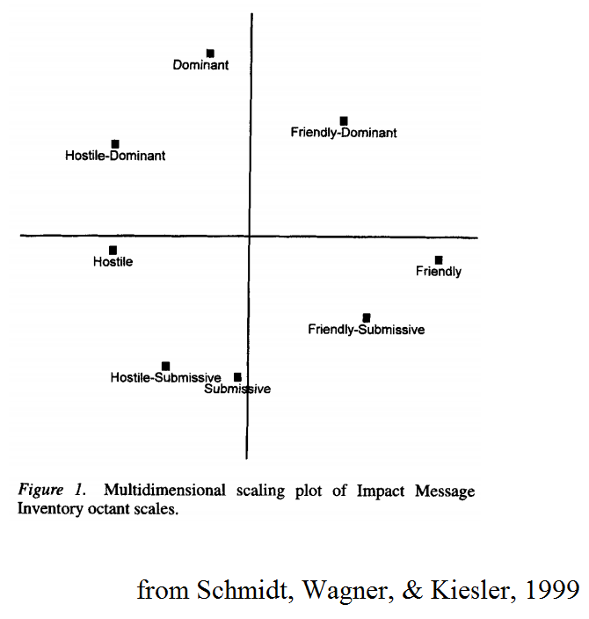
Impact Message Inventory (IMI: Perkins, Kiesler, Anchin, Chirico, Kyle, & Federman, 1979; IMI-C: Schmidt, Wagner, & Kiesler, 1999)
Measures the covert reaction of the listener to the speaker’s behavior
Notes:
[Read first bullet] The original measure is a self-report, and the IMI-C combines both self-report and observational ratings. The authors state that it measures quote, “momentary emotional and other engagements of one person by another during ongoing transactions in counseling/psychotherapy and other dyads.” So said differently, the IMI measures aspects of relationship behaviors (“affective, cognitive, and behavioral covert engagements) in dyads. Stated another way, the measure reports as the therapist’s “love” and “hate” reactions to the client’s behavior. The authors believe that these reactions generalize to other individuals in the client’s life (e.g., family and friends). It has acceptable reliability.

Slide 19
Social Relations Survey (SRS; Lorr, Youniss, & Stefic, 1991)
128 true / false items
Domains: social assertiveness, defense of rights, positive feeling, directiveness, approval need, confidence, perceived approval, & empathy
Notes:
[Click] Developed to measure eight hypothesized constructs theorized to be most important in developing social skills. The SRS is intended to specifically measure the broader construct of assertiveness behavior or social skill effectiveness. It has good validity, especially discriminant validity, and adequate to strong reliability across its 8 subscales.

Slide 20
Interpersonal Competence Questionnaire (ICQ; Buhrmester, Furman, Wittenberg, & Reis, 1988)
40 item self-report
Domains: initiating relationships, disclosing personal information, asserting displeasure with others, providing emotional support, & managing interpersonal conflict
Notes:
[Read bullets]. Its questions are on a 5 point Likert scale. Higher scores mean feeling more comfortable and competent with the different domains. It has satisfactory outcomes from confirmatory factor analysis, and acceptable average reliability of .82 across several studies. Generally good construct validity when comparing it to similar measures.

Slide 21
Some suggestions for clinicians
Try out the excellent tools that are out there
Understand your own assumptions and the theoretical basis you’re working from
Notes:
So to begin summing up this information, what should clinicians consider when they are working on interpersonal functioning? [Read the first bullet], of which there are many both within the FAP tradition and in other traditions, and [read the second bullet]. Many of these instruments are developed from a diversity of theoretical backgrounds. Using measures consistent with your own worldview is likely going to be more useful to you.

Slide 22
Some suggestions for researchers
Pursue research consistent with CBS principles
Develop tight, functional definitions of our constructs of interest
Maintain a commitment to diverse designs and measurements
Notes:
So, there are also things I think researchers should consider. [Click] First, consistent with other branches of CBS, FAP research should emphasize processes of change, multi-method and multi-level measurement, and mediation / moderation analyses. [Click] Second, we should be able to specify precisely what we mean when we refer to any construct, and be able to define it functionally. [Click] Finally, we should consider multiple measurement and research design paradigms, in order to build progressive lines of research that ask and answer interesting questions.

Slide 23
Thank You!
tkfeeney1@gmail.com - corystanton@nevada.unr.edu - follette@unr.edu
Up next: Bill will discuss the complexities of functional assessment for therapists

Slide 24
References (in order of citation)
Follette, W. C., & Houts, A. C. (1996). Models of scientific progress and the role of theory in taxonomy development: A case study of the DSM.. Journal of Consulting and Clinical Psychology, 64(6), 1120-1132.
Bonow, J. T., & Follette, W. C. (2009). Beyond values clarification: Addressing client values in clinical behavior analysis. The Behavior Analyst,32(1), 69-84.
Goldiamond, I. (1974). Toward a constructional approach to social problems: ethical and constitutional issues raised by applied behavior analysis. Behaviorism, 2(1), 1-84.
Seeman, T. E. (1996). Social ties and health: The benefits of social integration. Annals of epidemiology, 6(5), 442-451.
Taylor, S. E. (2011). Social support: A review. The handbook of health psychology, 189-214.
Laursen, B. (2005). Dyadic and group perspectives on close relationships.International Journal of Behavioral Development, 29(2), 97-100.
Kohlenberg, R.J., & Tsai, M. (1991). Functional Analytic Psychotherapy: Creating intense and curative therapeutic relationships. New York, NY: Springer.
Hayes, S. C., Nelson, R. O., & Jarrett, R. B. (1987). The treatment utility of assessment: A functional approach to evaluating assessment quality. American Psychologist, 42(11), 963-974.
Tsai, M., Kohlenberg, R. J., Kanter, J. W., Kohlenberg, B., Follette, W. C., & Callaghan, G. M. (2009). A guide to functional analytic psychotherapy: Awareness, courage, love and behaviorism. New York, NY: Springer.

Slide 25
References (in order of citation)
Callaghan, G. M., Follette, W. C., Ruckstuhl Jr, L. E., & Linnerooth, P. J. (2008). The Functional Analytic Psychotherapy Rating Scale (FAPRS): A Behavioral Psychotherapy Coding System. The Behavior Analyst Today,9(1), 98.-116.
Callaghan, G. M. (2006). The Functional Idiographic Assessment Template (FIAT) system: For use with interpersonally-based interventions including Functional Analytic Psychotherapy (FAP) and FAP-enhanced treatments.The Behavior Analyst Today, 7(3), 357-398.
Darrow, S. M., Callaghan, G. M., Bonow, J. T., & Follette, W. C. (2014). The Functional Idiographic Assessment Template-Questionnaire (FIAT-Q): Initial psychometric properties. Journal of Contextual Behavioral Science, 3(2), 124-135.
Leonard, R. C., Knott, L. E., Lee, E. B., Singh, S., Smith, A. H., Kanter, J., ... & Wetterneck, C. T. (2014). The development of the functional analytic psychotherapy intimacy scale. The Psychological Record, 64(4), 647-657.
Kanter, J. W., Tsai, M., Holman, G., & Koerner, K. (2013). Preliminary data from a randomized pilot study of web-based functional analytic psychotherapy therapist training. Psychotherapy, 50(2), 248-257.
Perkins, M. J., Kiesler, D. J., Anchin, J. C., Chirico, B. M., Kyle, E. M., & Federman, E. J. (1979). The Impact Message Inventory: A new measure of relationship in counseling/psychotherapy and other dyads. Journal of Counseling Psychology, 26(4), 363-367.
Schmidt, J.A., Wagner, C.C., & Kiesler, D.J. (1999). Psychometric and circumplex properties of the Octant Scale Impact Message Inventory (IMI-C): A structural evaluation. Journal of Counseling Psychology, 46(3), 325-334.
Lorr, M., Youniss, R.P., & Stefic, E.C. (1991). An inventory of social skills. Journal of Personality Assessment, 57(3), 506-520.
Buhrmester, D., Furman, W., Wittenberg, M. T., & Reis, H. T. (1988). Five domains of interpersonal competence in peer relationships. Journal of Personality and Social Psychology, 55(6), 991-1008

